Slide 1
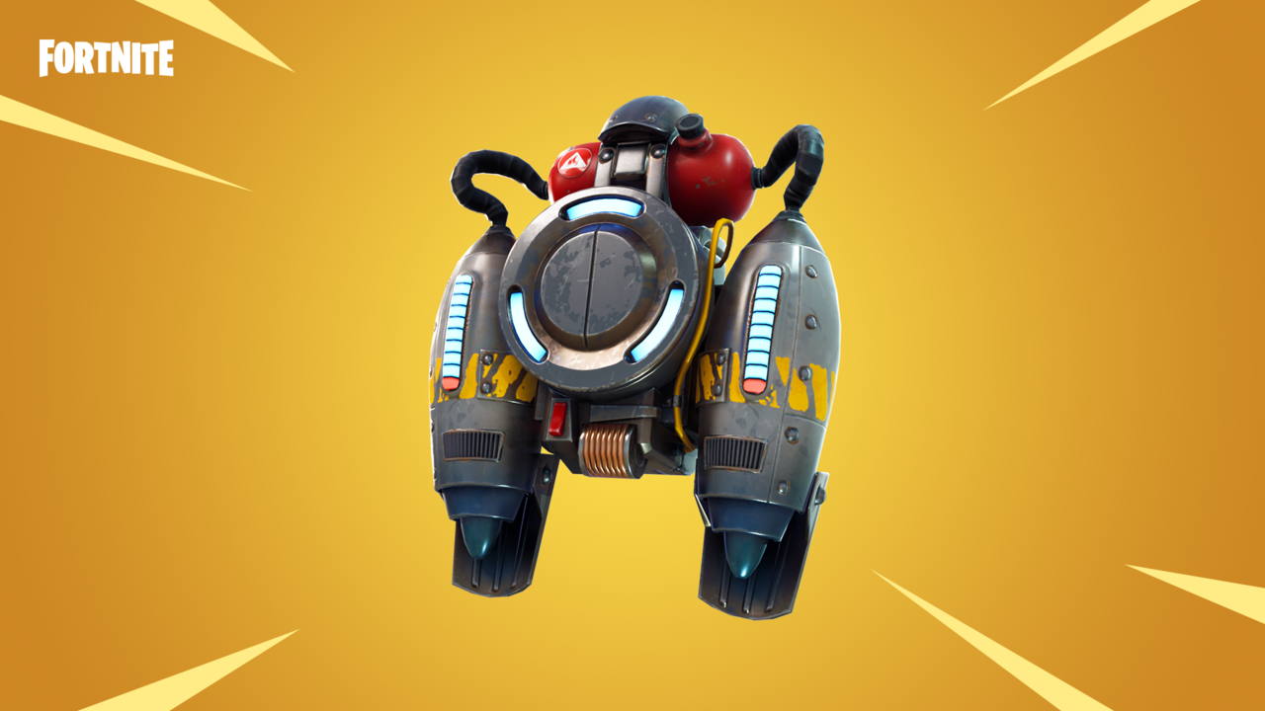
Jetpacks
By Everett Agresta and Grayson Hammer
Wendell Moore’s neighbour’s son describes learning to fly the Rocket Belt like “trying to balance while standing on a beach ball on the ocean”.

Slide 2
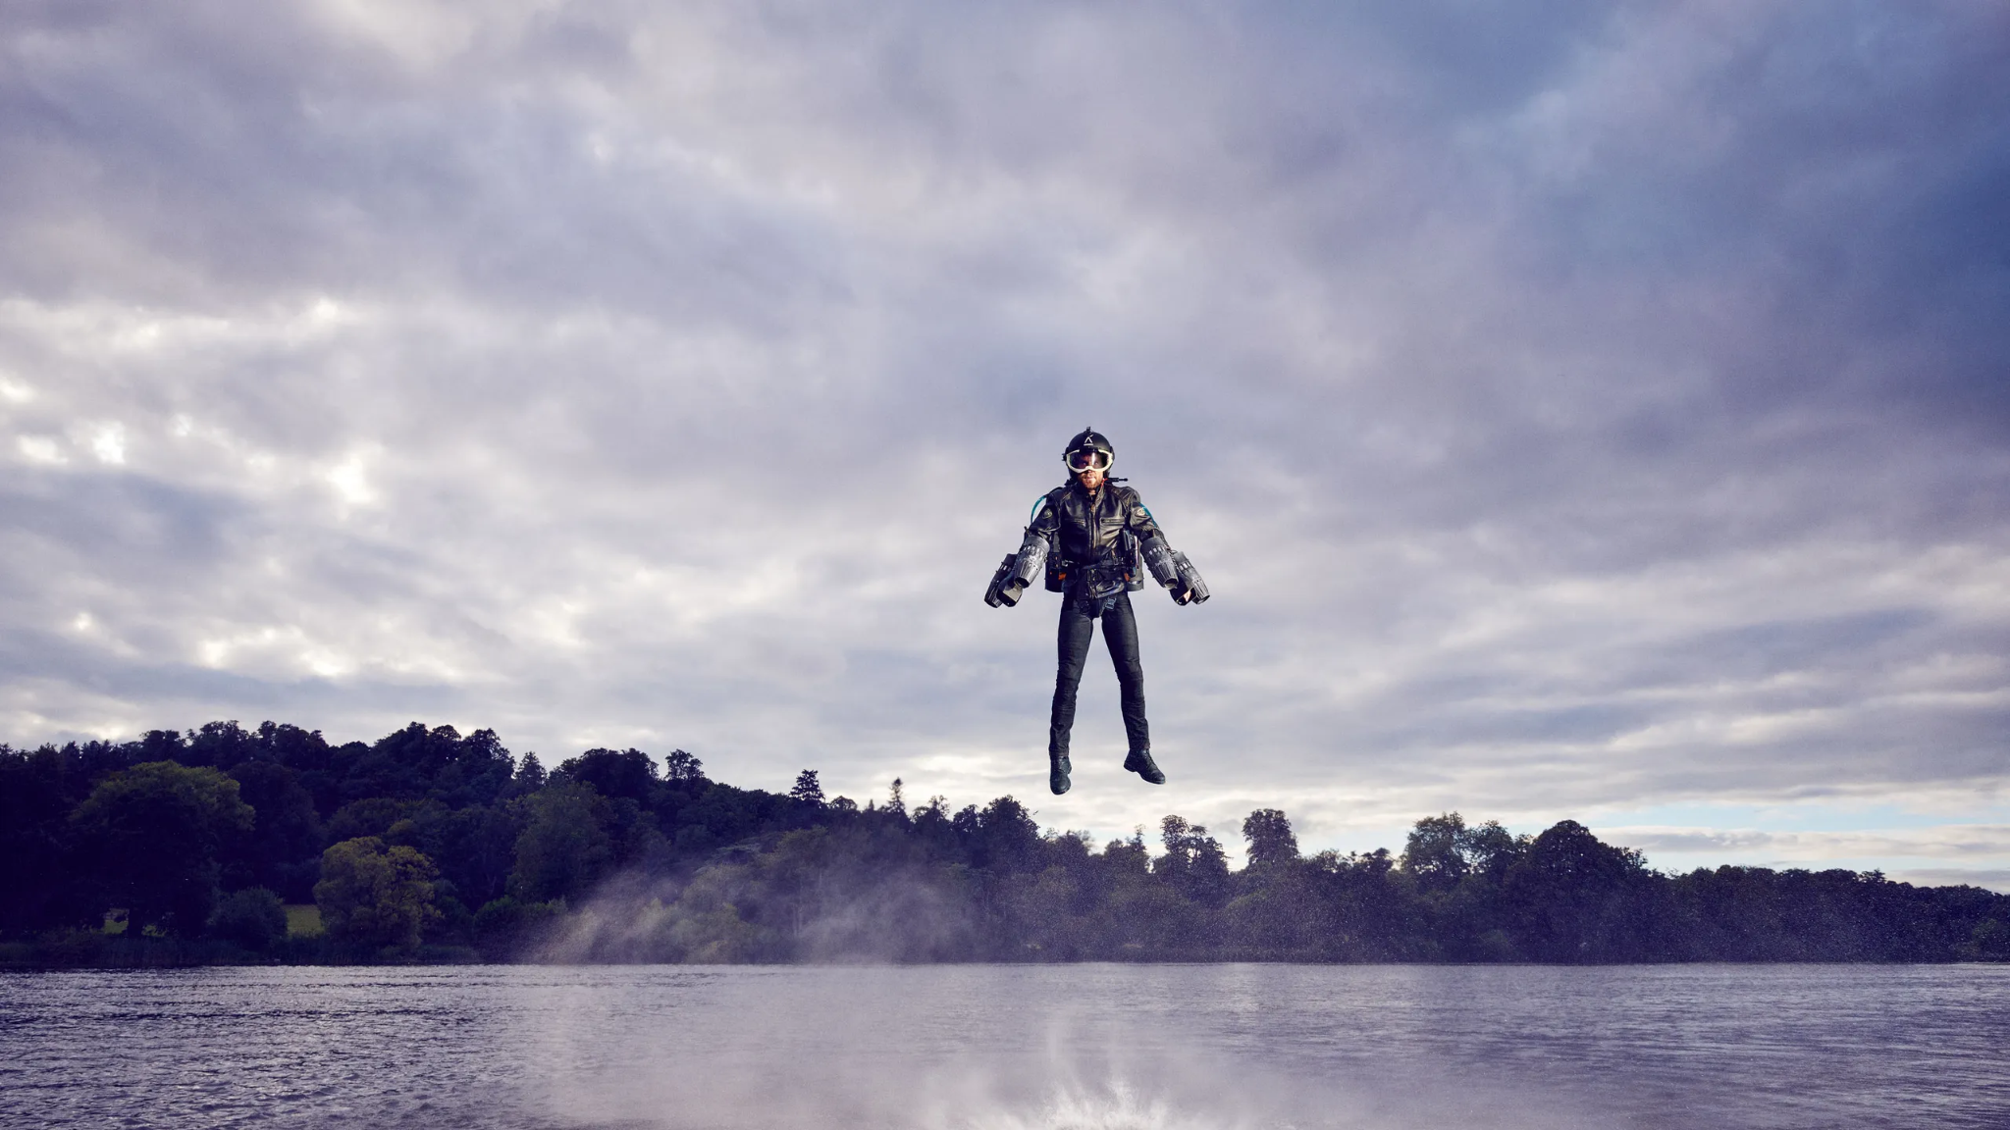
Overview
History
Plan and Implementation
Disadvantages
Benefits
Uses of a Jet Pack
Summary
Citations

Slide 3
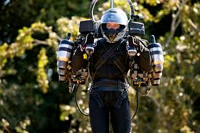
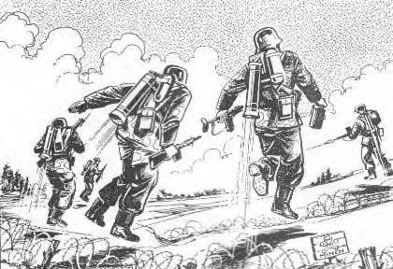
History
Alexander Andreev in 1919(Russia)
Himmelsturmer(Sky Stormer)
Notes:
Alexander Andrev came up with idea of an engine in a backpack
Used to jump rivers in WWll(1950)

Slide 4
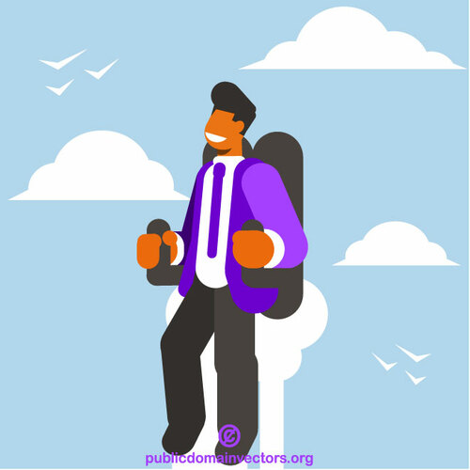
History
Used to transport soldiers across difficult terrain
Rocket Belt (Wendell More)
Jet engine (1965)(5 min flight time)
Notes:
Rocket Belt was hard to learn to fly and even today, only a handful of people have flown the device.
Williams developed the WR19, a small-scale turbo jet engine with a thrust of 1,900 newtons to replace the hydrogen-peroxide rocket

Slide 5
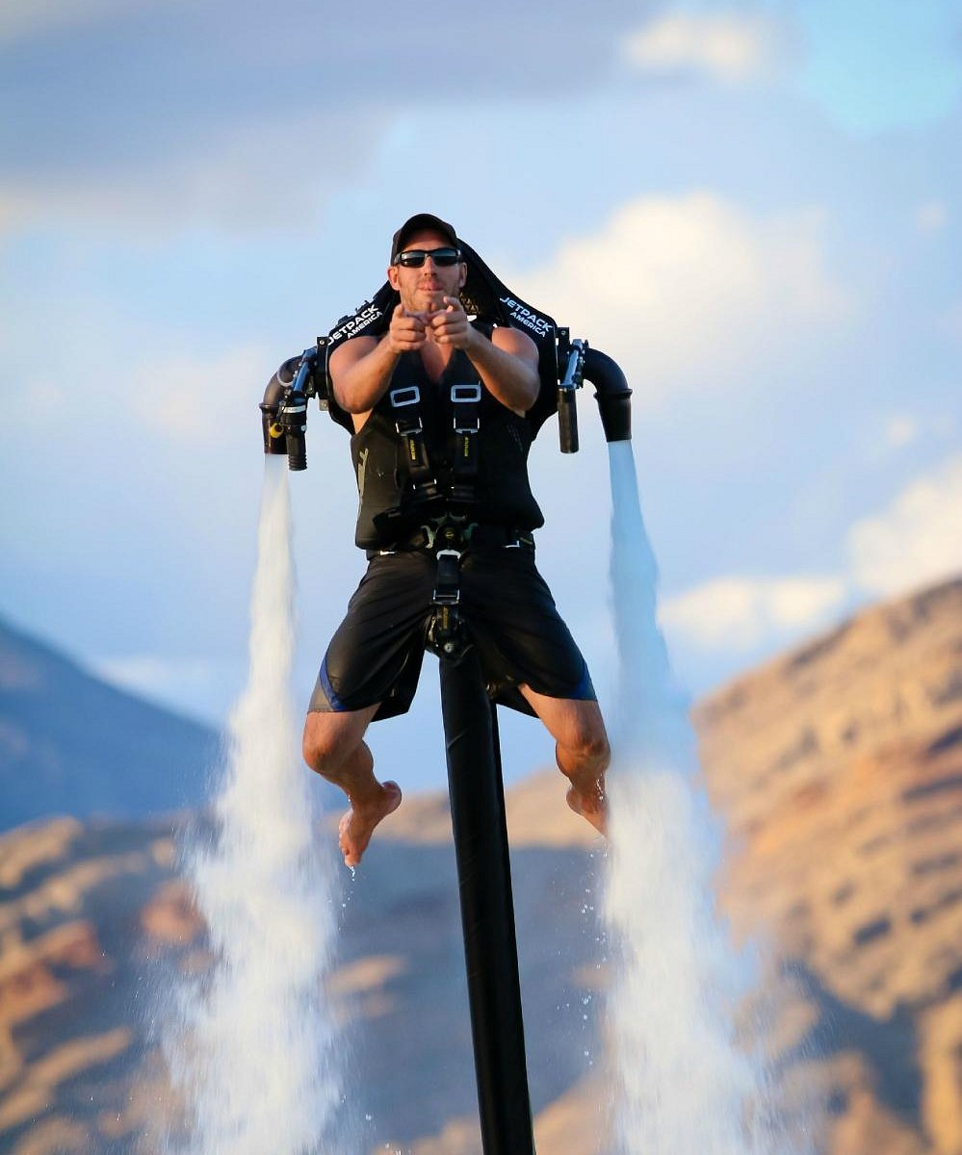
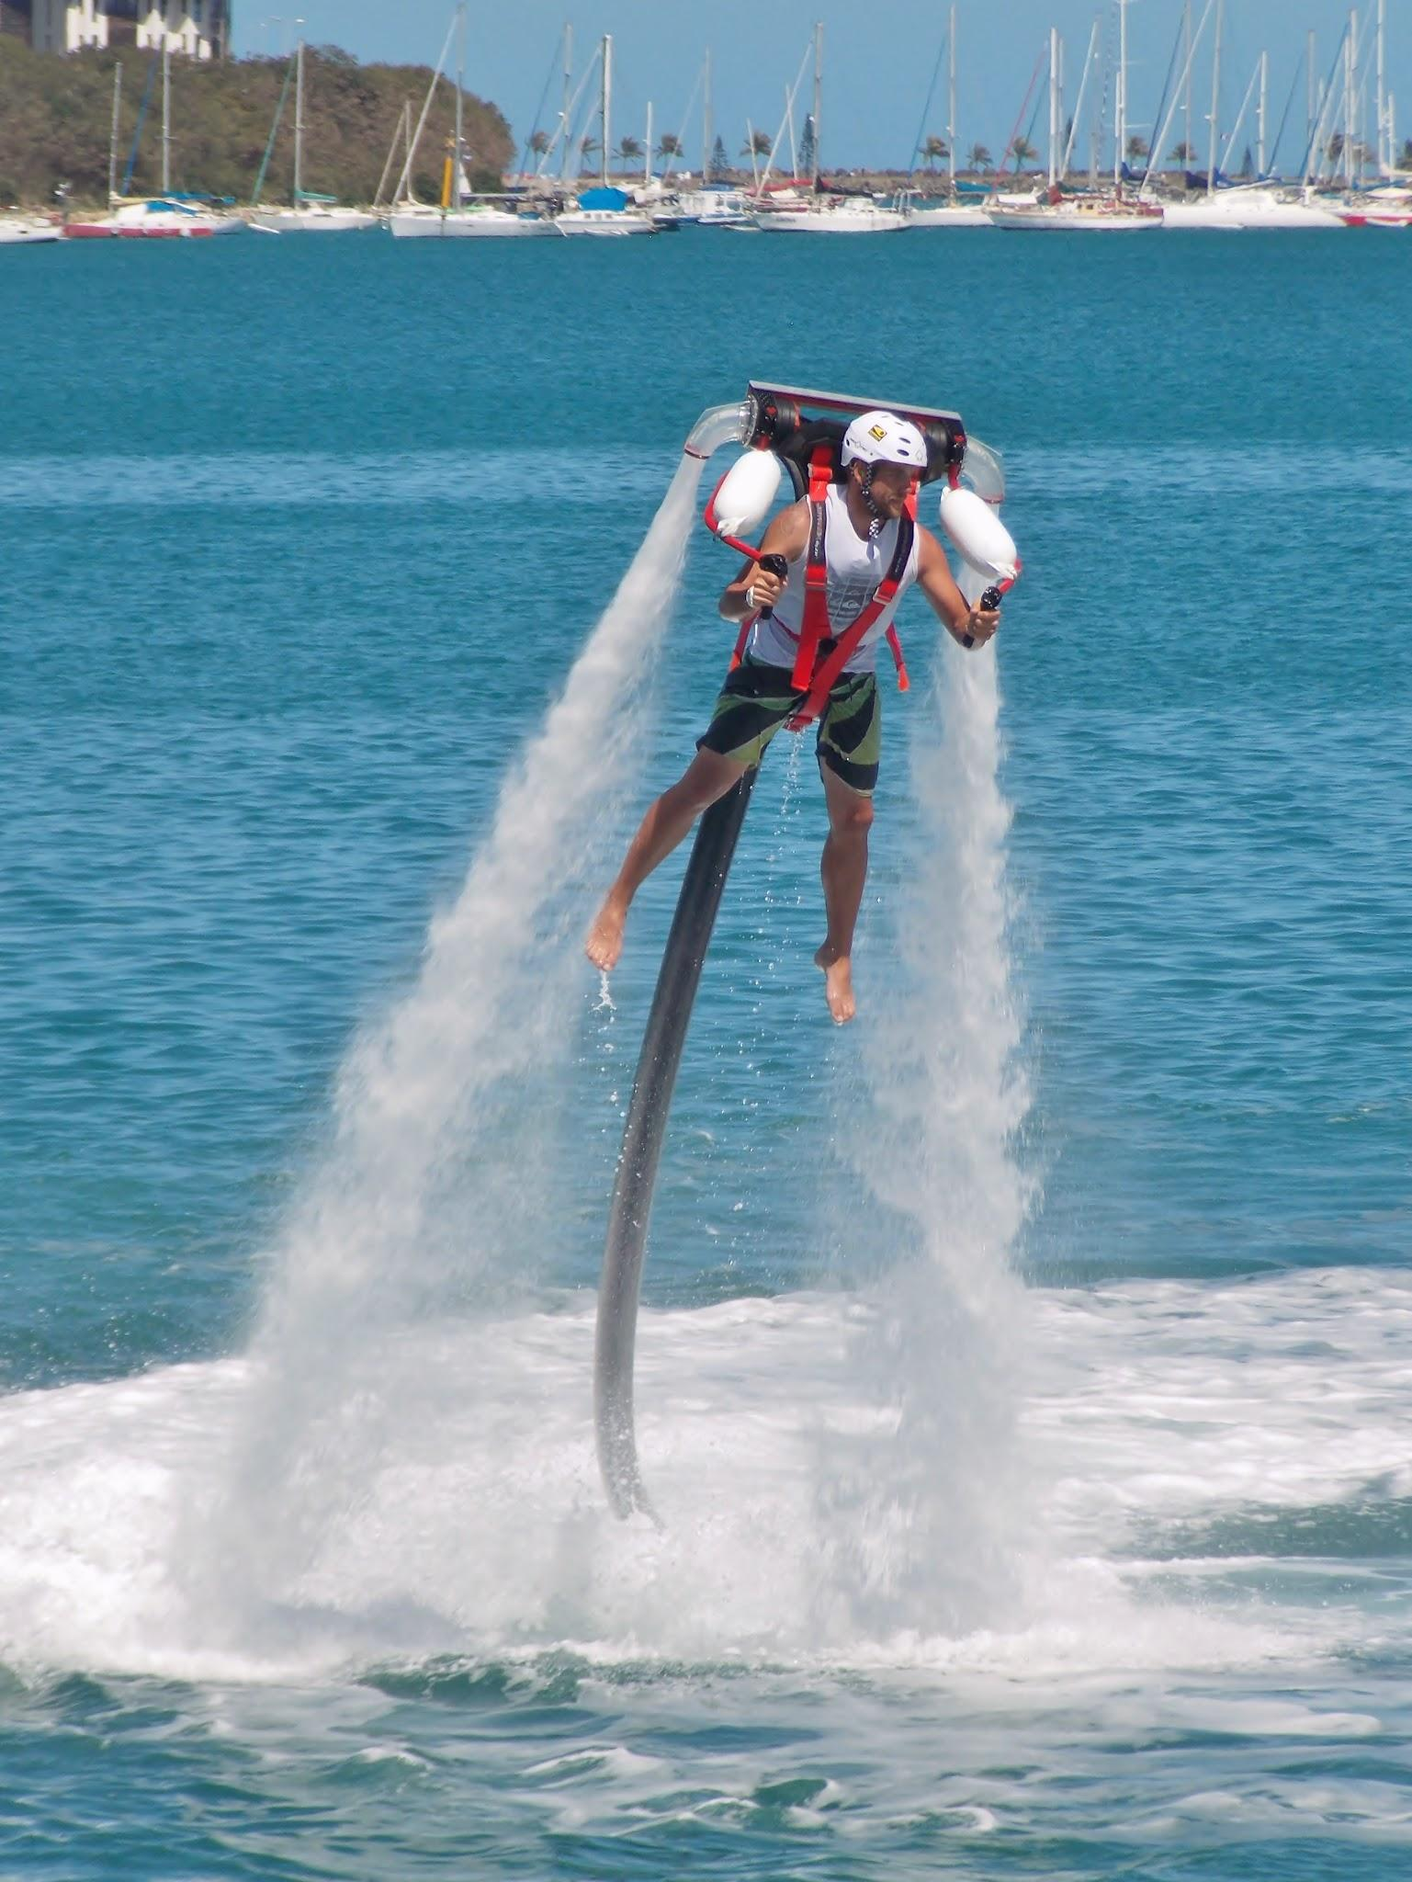
History
Jetpack Aviation( micro gas turbines)
JetLev ( a water propelled jet pack)
For Fun
Notes:
The newer Jetlev R200x is a water-powered jetpack connected, by a hose, to a Jet Ski. More than 1,000 gallons of water a minute pump through the hose; the cascade shoots out two nozzles attached to the backpack, sending the rider into the air.
Can be rented for $300-500 per hour.

Slide 6
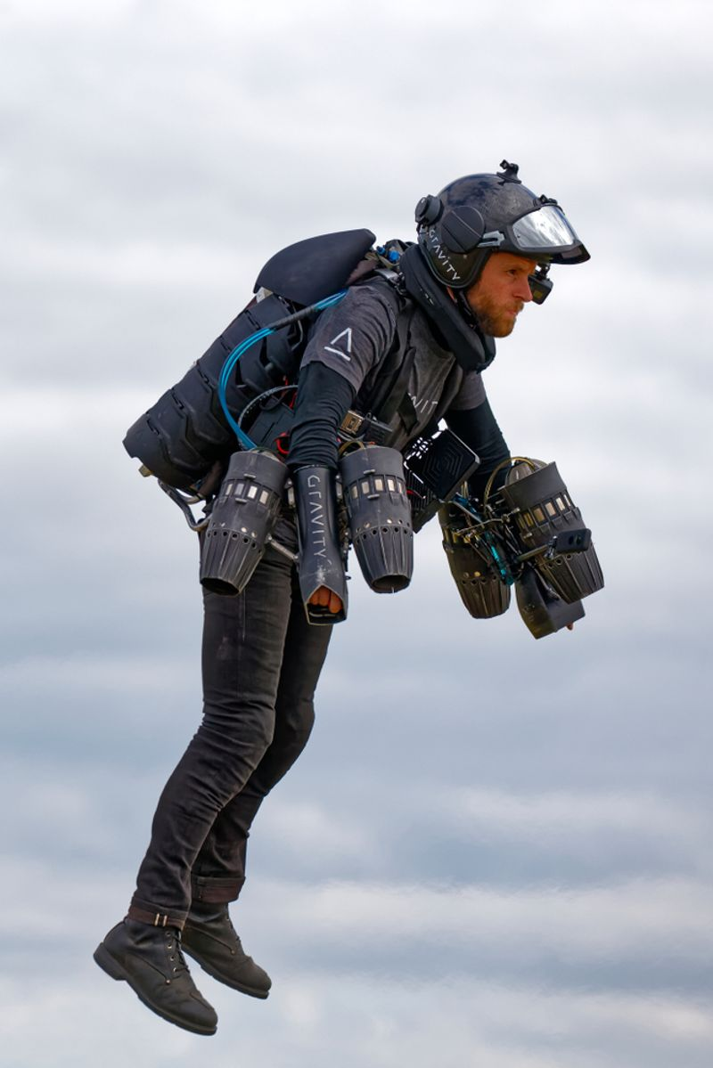
Plan and Implementation
People that live in cities
Commute to work
Military operations
Sea travel

Slide 7
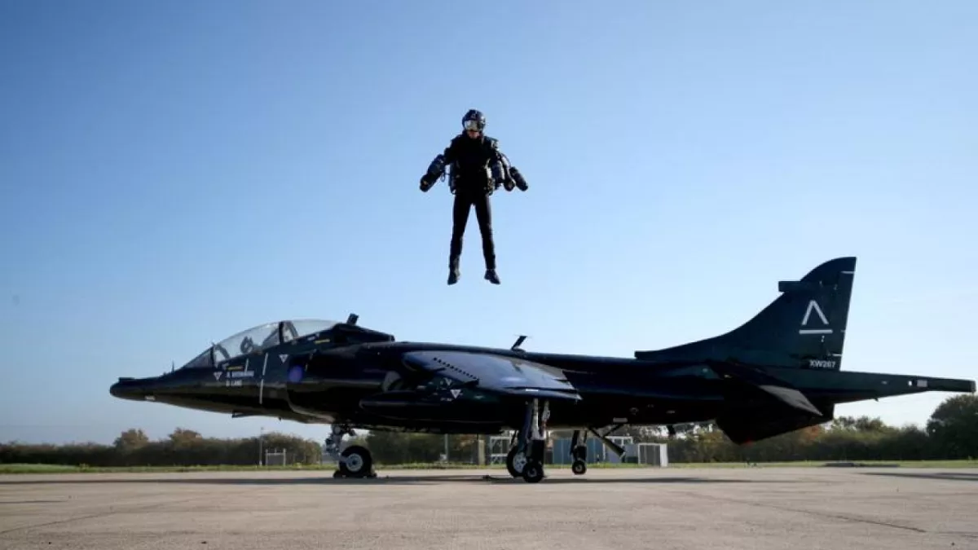
Disadvantages
Landing can provoke spinal injuries.
Limited operating time.
Expensive ($300,000)
Short duration of flight
A high expense of the peroxide propellant.
Lasts about 5-45 minutes.
Notes:
These disadvantages make it harder to make these a possibility to use for real life situations
If we could improve and make the disadvantages not occur when using Jet Packs then we could buy more for people to use, and not have to go in airports and planes.

Slide 8
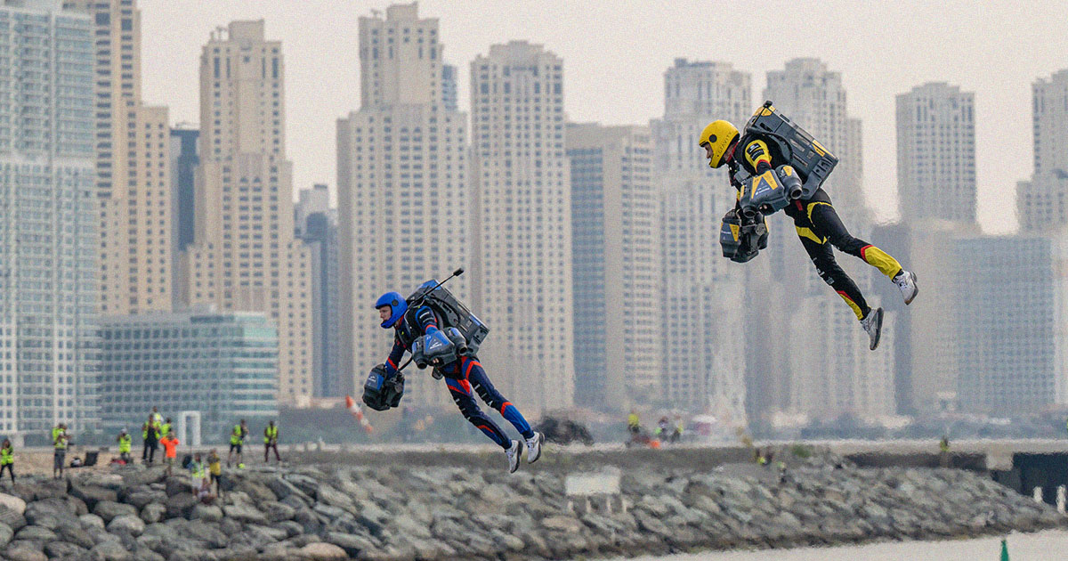
Benefits
Get used in the military
It increases website traffic
It provides excellent security
It offers centralization site management
Skip Traffic
Less Airports for air travel
Allows vertical takeoff and landing
Notes:
The benefits to Jet Packs could change lives and make things move a lot smoother, and make it easier to navigate from place to place.
They can be used in emergency situations and even to help military forces travel across places quicker and smoother.

Slide 9
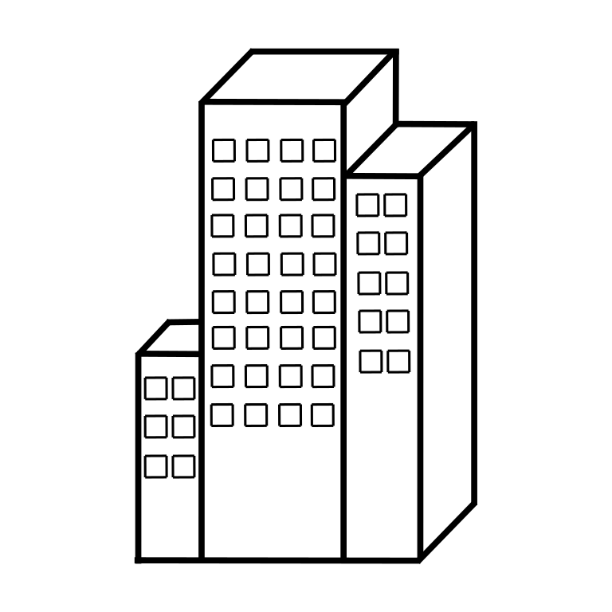
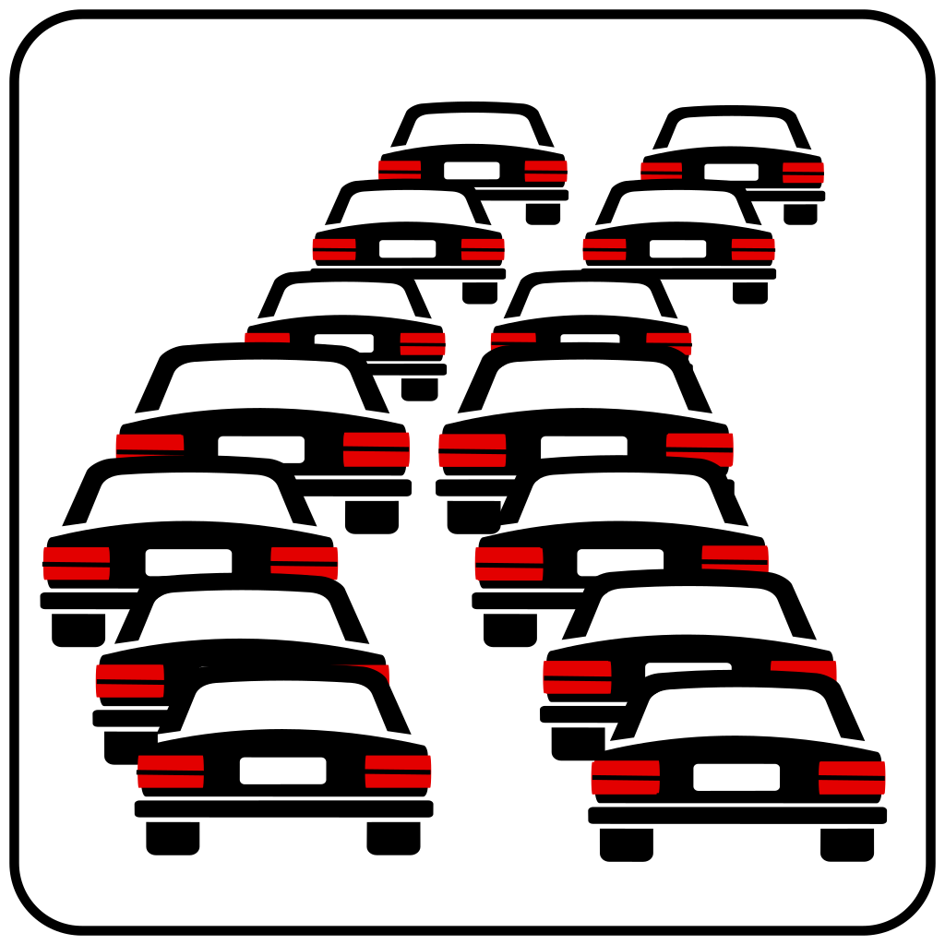
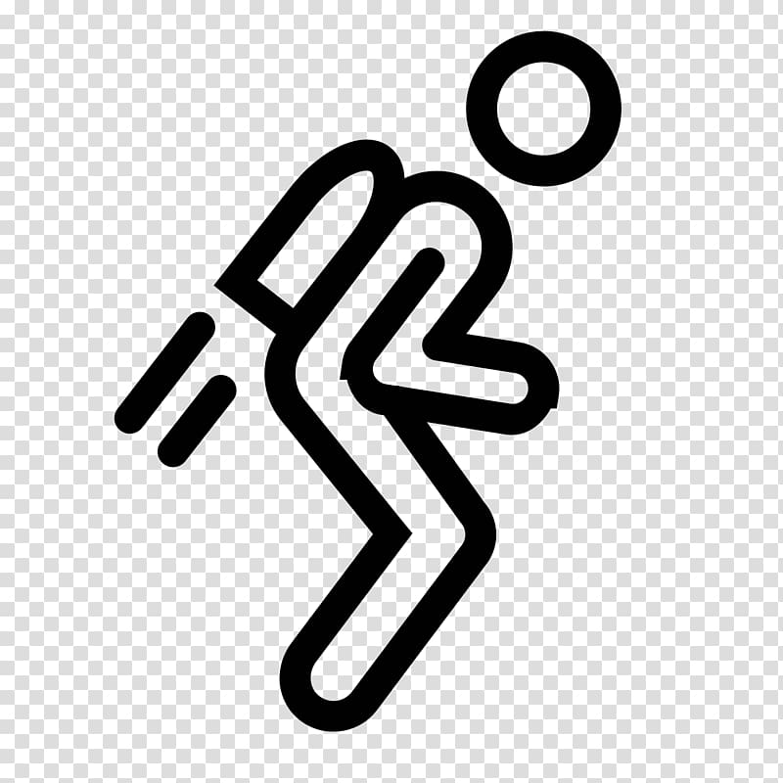
Uses of a Jet Pack!!!
Commute to work or events
Notes:
Good for commuting to work.
traffic/distance

Slide 10
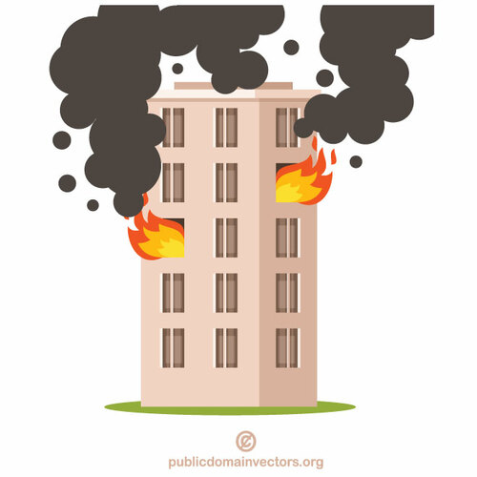
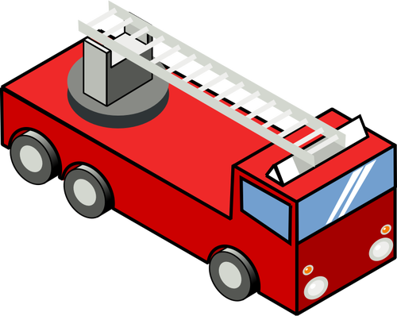
Notes:
The jet pack could be of great value to the fire department as it can reach high buildings without going directly through the building for medical emergencies or fires.

Slide 11
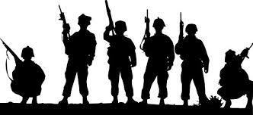
Military operations
Notes:
Military can use them on missions where they need to cross a distance fast and have access to air and ground quickly.

Slide 12
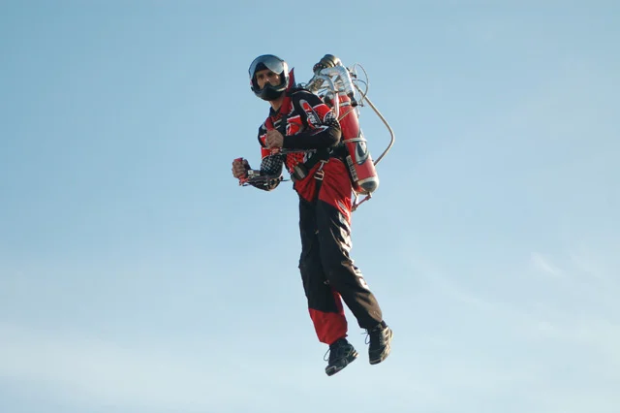
Summary
The jet pack provides a convenient way to travel and reach places over difficult terrain or up on high buildings. Regardless of the cost or slight dangers, the future development of jet packs could have a critical effect on the lives of billions of people.

Slide 13
Citations
History of Jet Packs
Timeline of Jet Packs
Advantages of Jet Packs

